Slide 1
Automated spatiotemporal annotation of sound objects in a scene
COMP.SGN.250 Signal Processing Innovation Project
Final Presentation
Einari VAARAS
Kalle LAHTINEN
Mehmet AYDIN

Slide 2
Introduction
Audio streams, such as broadcast news, documentaries and personal videos contain sounds from a wide variety of sound sources
These streams include detectable audio events of interest, such as speech, music or sounds of animals
Beside the detection of sound event presence there is a need for detecting the direction of arrival (DOA) of the detected sound event. For such cases Deep Learning methods are often used but requires annotated data which is laborious and difficult to do reliably
The aim is to explore the possibility of automatically annotating spatial and temporal dimensions of sound objects detected in an audio stream with the help of a 360-degree

Slide 3
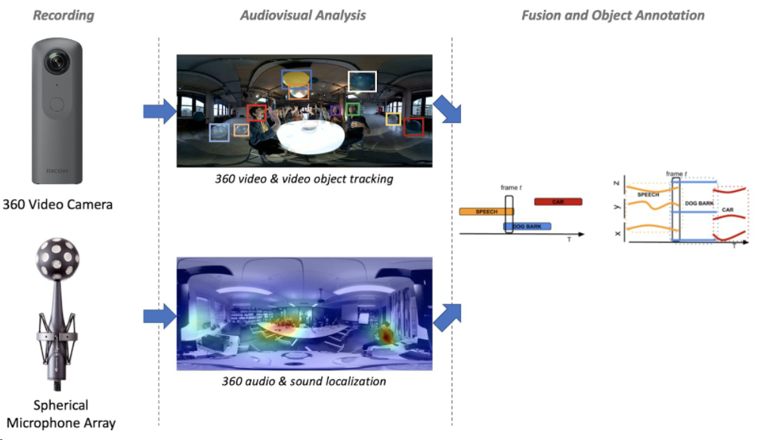

Slide 4
Introduction
Studying object detection methods for 360-degree video data
Determining and defining the scenes to be recorded
Recording spatiotemporal scenes with a 360-degree camera and integrated 360-degree microphone
Applying object detection to the video recording
Extracting temporal object detections and their locations from the video recording
Formulating spatiotemporal labels for the audio data by combining video and audio detections

Slide 5
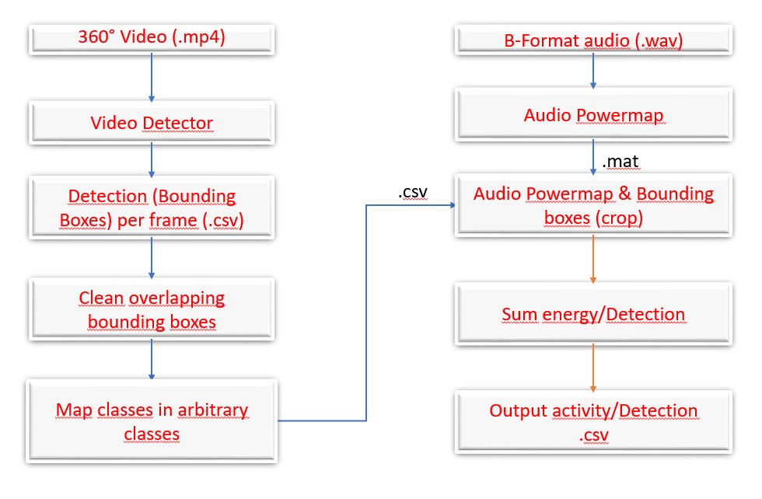
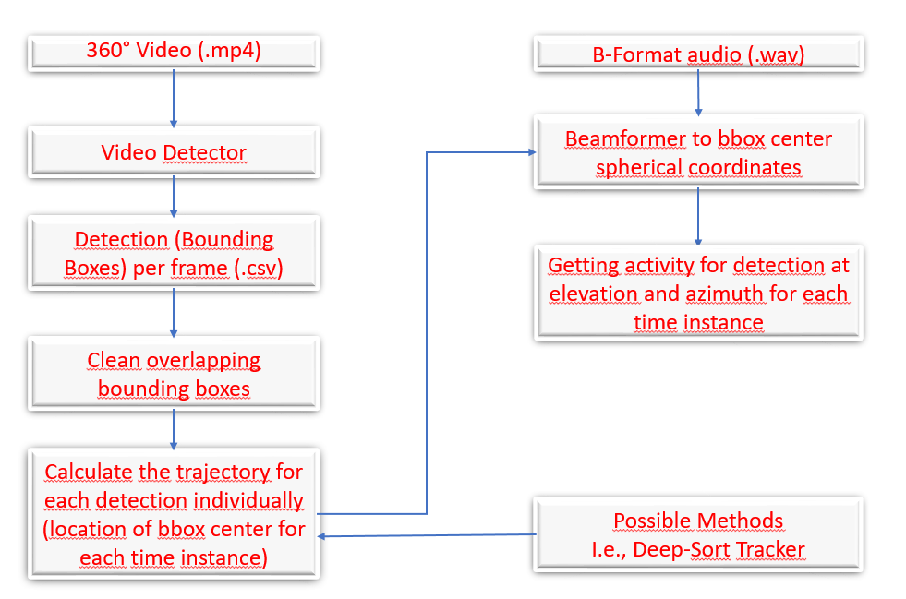
Block Diagram of the work flow
Pipeline version 1
Pipeline version 2

Slide 6
Pipeline version 1

Slide 10
Clean overlapping bounding boxes
Basic idea of algorithm:
If there are same classes present in the same video frame:
If there are overlapping bounding boxes (determined by IoU):
If overlap exceeds a predetermined threshold:
Remove bounding box with least confidence
Video demo

Slide 11
Class mapping function
It is possible to change the class indeces and names of classes into arbitrary classes
Video demo

Slide 12
Audio powermap
A function made by Archontis converts the B-format audio into a powermap
MUSIC algorithm used
(Some other details?)
Video demo

Slide 13
Crop powermap using bounding boxes
(Something here)
Video demo

Slide 14
Determine energy based on cropped powermap
(Something here)
CSV file demo
Coordinates converted to spherical coordinates

Slide 15
Pipeline version 2

Slide 16
Beamforming
Beamforming can also be used to determine audio activity
”Listens” to a pointed direction
How to get a pointed direction?
Multi-frame (video) audio segments
Frame-level (video) audio segments
DeepSORT

Slide 17
Multi-frame (video) audio segments
We want to find the temporal trajectories of visual objects (from the video tracker)
Problem: how to find correspondences between objects in consecutive frames?
Have only one object present in video (current implementation)
File demo
Some more advanced method, e.g. a video object tracker
Handle everything on frame-level

Slide 18
Frame-level (video) audio segments
Basic idea:
For each frame:
Take the 100-ms audio segment corresponding to the video frame (video at 10 fps)
List all detected objects within the frame
For each object in a frame, give the bounding box center coordinates (azimuth, elevation) to the beamformer
File demo

Slide 19
DeepSORT
DeepSort is a traditional single-hypothesis multi-target tracking method using recursive Kalman filtering and frame-by-frame data correlation.
DeepSort adopts the fusion metric that combining the distance of predicted position and the observed position in the Markov space and the cosine distance of the apparent feature between the bounding boxes in the Kalman filter.

Slide 20
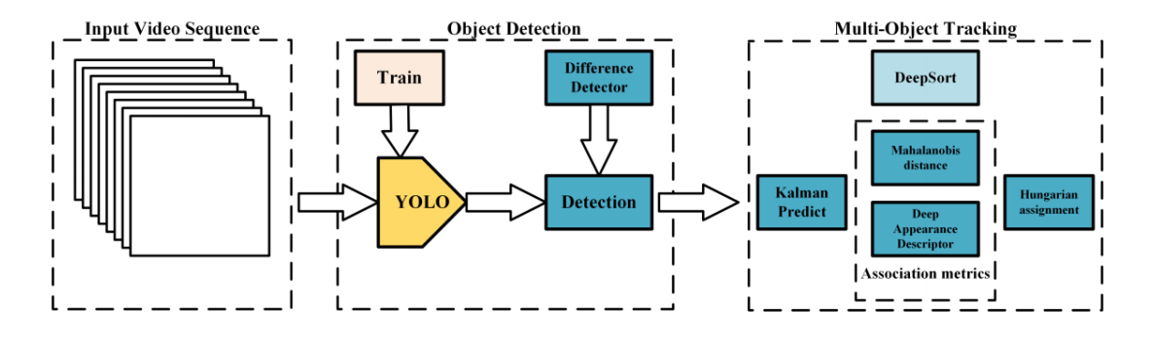
Figure : The workflow of real-time detection and tracking [1]

Slide 21
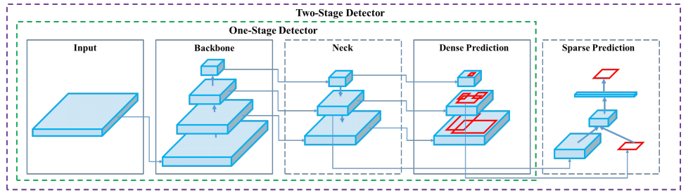
Figure : Architecture of object detection of YOLOv4 [2]
Input: {image, patches, image pyramid}
Backbone: {VGG16, ResNet50, ResNeXt-101, Darknet53}
Neck:
Head:
Dense Prediction: {RPN, YOLO, SSD, Retina-Net, FCOS}
Sparse Prediction: {Faster R-CNN, R-FCN} [2]

Slide 22
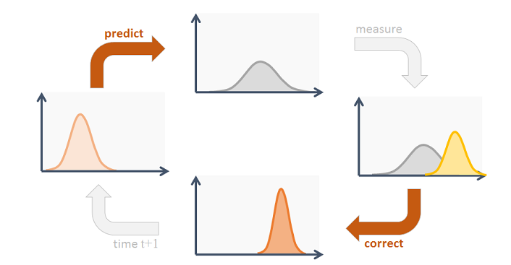
Kalman Filter
Source:https://www.codeproject.com/Articles/865935/Object-Tracking-Kalman-Filter-with-Ease

Slide 23
References
[1] Xu Zhang, Xiangyang Hao, Songlin Liu, Junqiang Wang, Jiwei Xu, Jun Hu, "Multi-target tracking of surveillance video with differential YOLO and DeepSort," Proc. SPIE 11179, Eleventh International Conference on Digital Image Processing (ICDIP 2019), 111792L (14 August 2019); doi: 10.1117/12.2540269
[2] Alexey Bochkovskiy,Chien-Yao Wang,Hong-Yuan Mark Liao, "YOLOv4: Optimal Speed and Accuracy of Object Detection ",2020

